Slide 1

CMSC 137
Data Communications and Networking
Lecture Module
09 – Bandwidth Utilization

Slide 2
Module 9: Bandwidth Utilization
Rozano S. Maniaol
Lecturer

Slide 3
Introduction
Bandwidth utilization is the wise use of available bandwidth to achieve specific goals
Efficiency can be achieved by multiplexing
Privacy and anti-jamming can be achieved by spread spectrum

Slide 4
Multiplexing

Slide 5
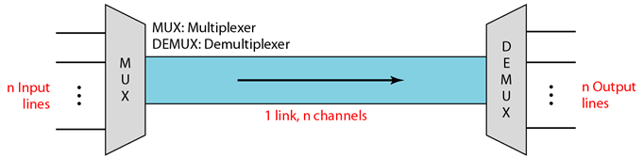
Multiplexing
Set of techniques that allow simultaneous transmission of multiple signals across a single link
Bandwidth of medium is greater than bandwidth needs of connected devices, link can be shared
Channel – portion of a link that carries a transmission between a given pair of lines

Slide 6
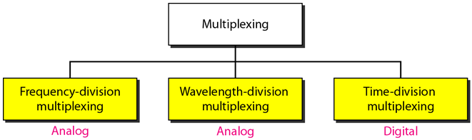
Categories of Multiplexing

Slide 7
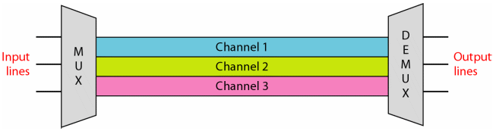
Frequency Division Multiplexing (FDM)
Analog technique that can be applied when the bandwidth of a link (in hertz) is greater than the combined bandwidths of the signal to be transmitted
Modulated signals are combined into a single composite signal
Channels can be separated by guard bands (strips of unused bandwidth) to prevent signals from overlapping

Slide 8
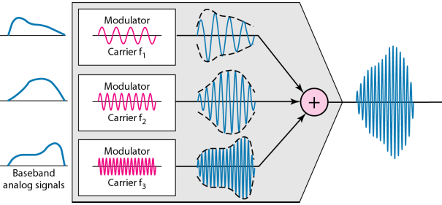
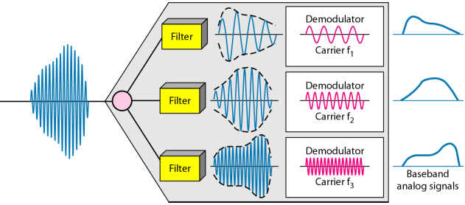
FDM Process

Slide 9
Analog Carrier System
Hierarchical system used by telephone companies that is made up of groups, supergroups, master groups and jumbo groups
12 voice channels are multiplexed onto a higher bandwidth line to create a group. A group has 48 kHz of bandwidth and support 12 voice channels
At next level, up to 5 groups can be multiplexed to create a composite signal called a supergroup. A supergroup has a 240 kHz and support up to 60 voice channel

Slide 10
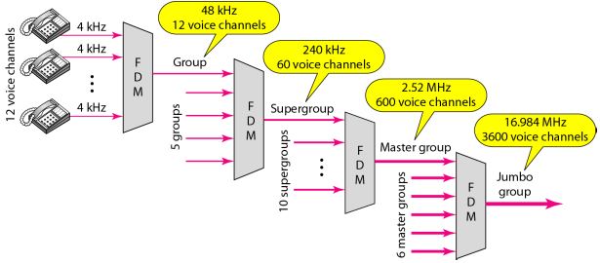
Analog Carrier System

Slide 11
Other applications of FDM
AM and FM radio broadcasting
  530 to 1700 kHz assigned to AM radio
  88 to 108 MHz assigned to FM radio (each station needs 200 kHz)
Television broadcasting (TV channel has 6 MHz each)
First generation of cellular telephones
  Each user is assigned two 30 kHz channels

Slide 12
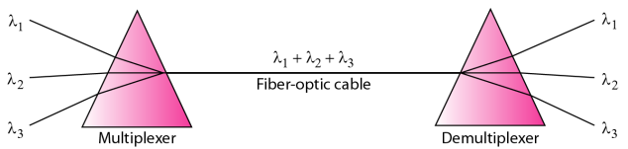
Wavelength Division Multiplexing (WDM)
Analog multiplexing technique that combines optic signals

Slide 13
WDM
One application is the SONET network
New method, called dense WDM (DWDM) can multiplex a very large number of channels by spacing channels very close to one another (greater efficiency)

Slide 14
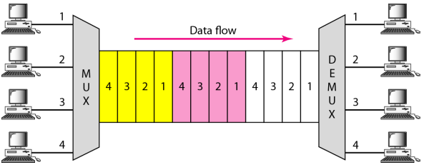
Time-Division Multiplexing (TDM)
Digital multiplexing technique for combining several low-rate digital channels into one high-rate channel
2 different schemes: synchronous TDM and statistical TDM

Slide 15
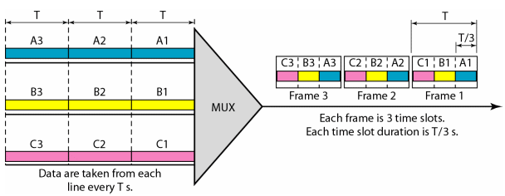
Synchronous TDM
Each input connection has an allotment in the output even if it is not sending data

Slide 16
Synchronous TDM
In synchronous TDM, the data rate of the link is n times faster, and the unit duration is n times shorter
What if the data rates of the inputs are different?
  Multilevel multiplexing – data rate of input is a multiple of others inputs
  Multiple-slot allocation – more than one slot per input
  Pulse stuffing – add dummy bits to inputs with lower rates
Framing bits follow a pattern, frame to frame,that allows the demultiplexer to synchronize with the incoming stream so that it can separate the time slots accurately

Slide 17
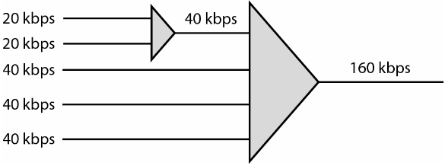
Multilevel Multiplexing

Slide 18
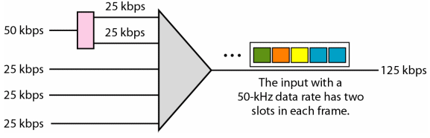
Multiple-slot Allocation

Slide 19
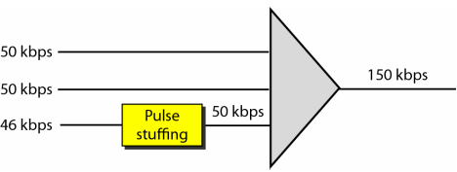
Pulse Stuffing

Slide 20
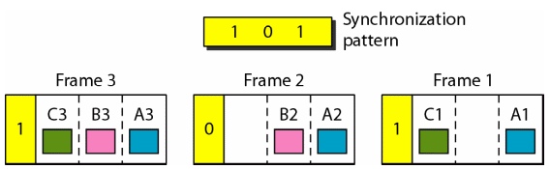
Framing bits

Slide 21
Statistical TDM
Slots are dynamically allocated to improve bandwidth efficiency
Number of slots in each frame is less than the number of input lines
Address field is needed in each frame
Data size-to-address size ratio must be reasonable
No synchronization bits
The capacity of the link is normally less than the sum of the capacities of each channel

Slide 22
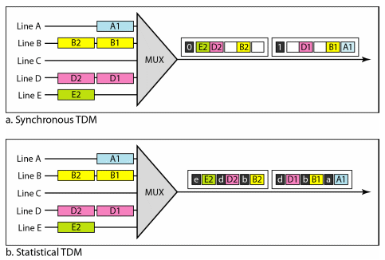
Synchronous vs Statistical TDM

Slide 23
Spread Spectrum

Slide 24
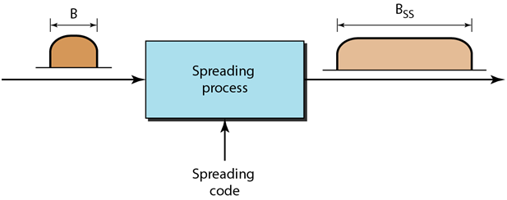
Spread Spectrum
For wireless applications
Must protect from eavesdroppers and jammers
Main technique is to add redundancy: if required bandwidth is B, B_{ss} > B
Signals are spread with different codes so that they can be separated at the receivers
Spreading process must occur after the signal is created by the source

Slide 25
Frequency Hopping Spread Spectrum (FHSS)
Uses M carrier frequencies modulated by the source signal
Modulation happens one carrier frequency after another
Pseudorandom noise (PN) creates a k-bit pattern for every hopping period T_{h}
The frequency table uses the pattern to find the frequency to be used for a hopping period and passes it to the frequency synthesizer
Frequency synthesizer creates the carrier signal of the selected frequency

Slide 26
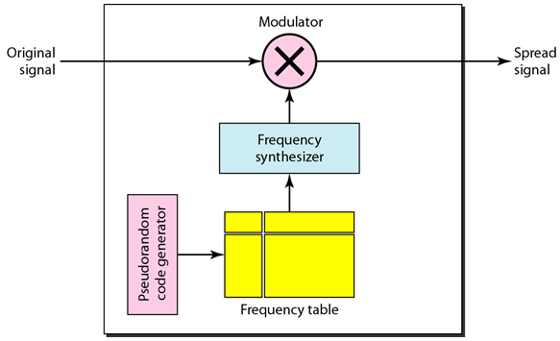
FHSS

Slide 27
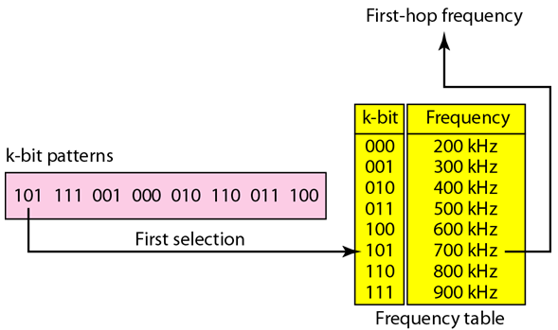
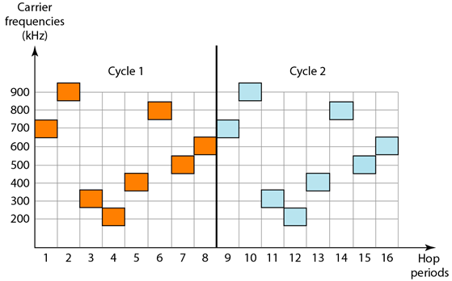
FHSS

Slide 28
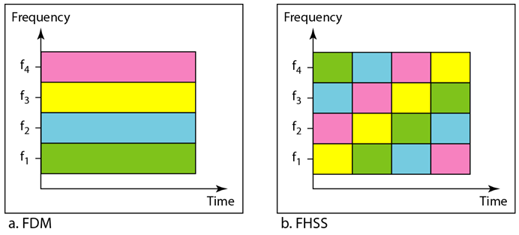
FDM vs FHSS

Slide 29
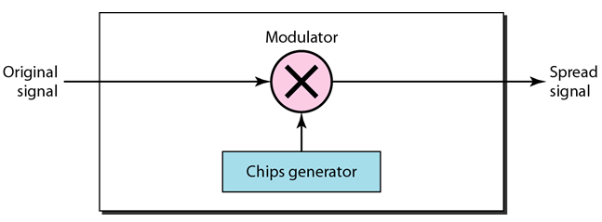
Direct Sequence Spread Spectrum (DSSS)
Replace each data bit with n bits using a spreading code, called chips
Chip rate is n times that of the data bit

Slide 30
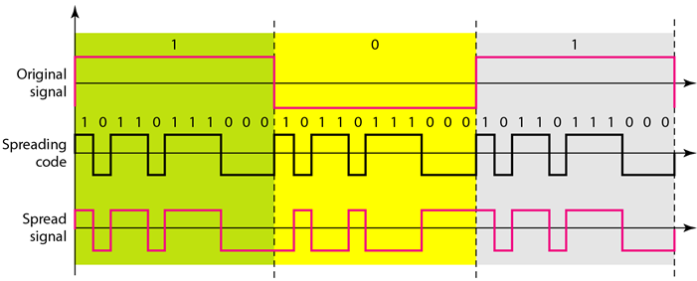
DSSS
Barker sequence, where n is 11 bits

Slide 31
References
Forouzan, B.A. 2013. Data Communications and Networking, 5th Ed. McGraw-Hill, New York.

